Slide 1
Combinational Logic II
CSE 4205: Digital Logic Design
Aashnan Rahman
Junior Lecturer
Department of Computer Science and Engineering (CSE)
Islamic University of Technology

Slide 2
01
BCD Adder
Binary adder with a little tweak

Slide 3
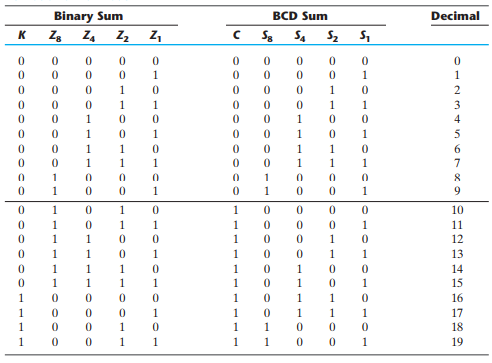
BCD Adder

Slide 4
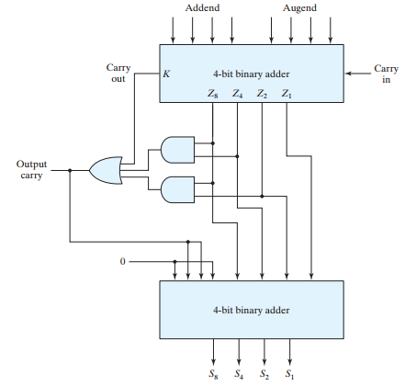
BCD Adder

Slide 5
02
Binary Multiplier

Slide 6
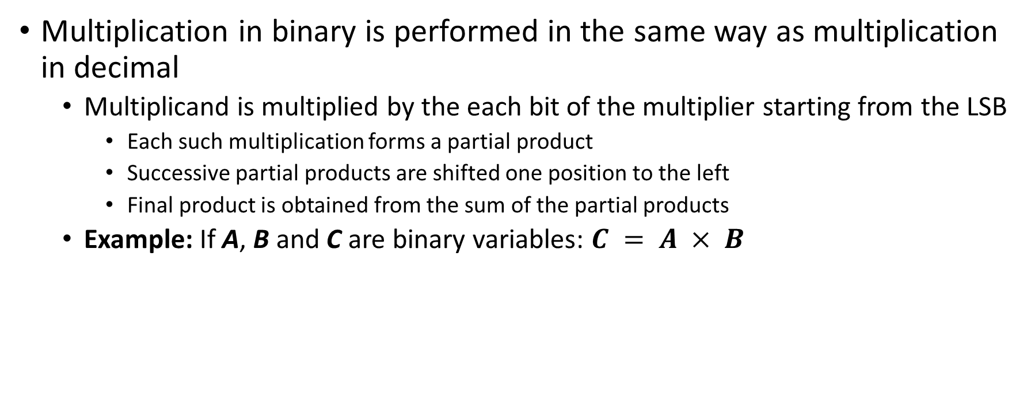
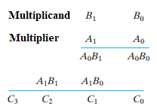
Binary Multiplier

Slide 7
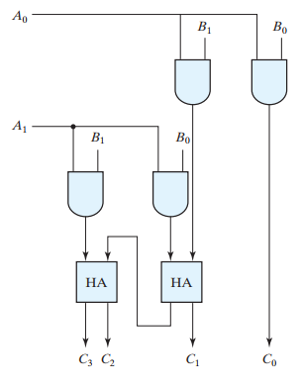
Two bit Binary Multiplier
Note: Multiplier with more bits can be constructed in a similar fashion

Slide 8
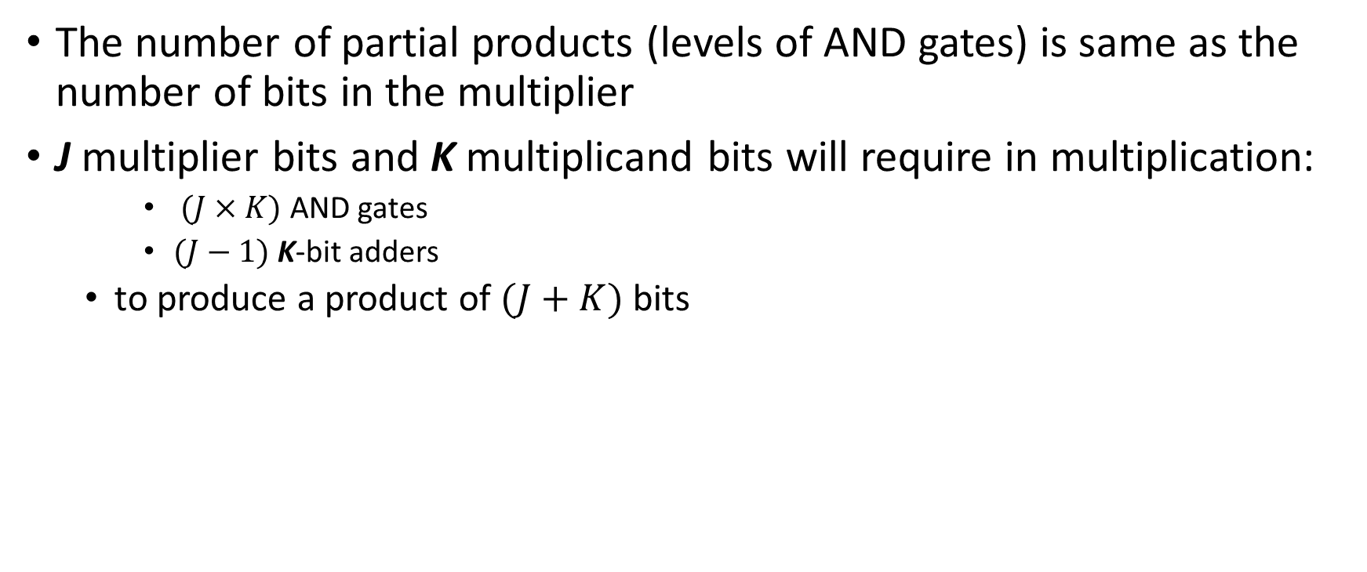
Binary Multiplier

Slide 9
03
Binary Magnitude Comparator
Which one is the larger value?

Slide 10
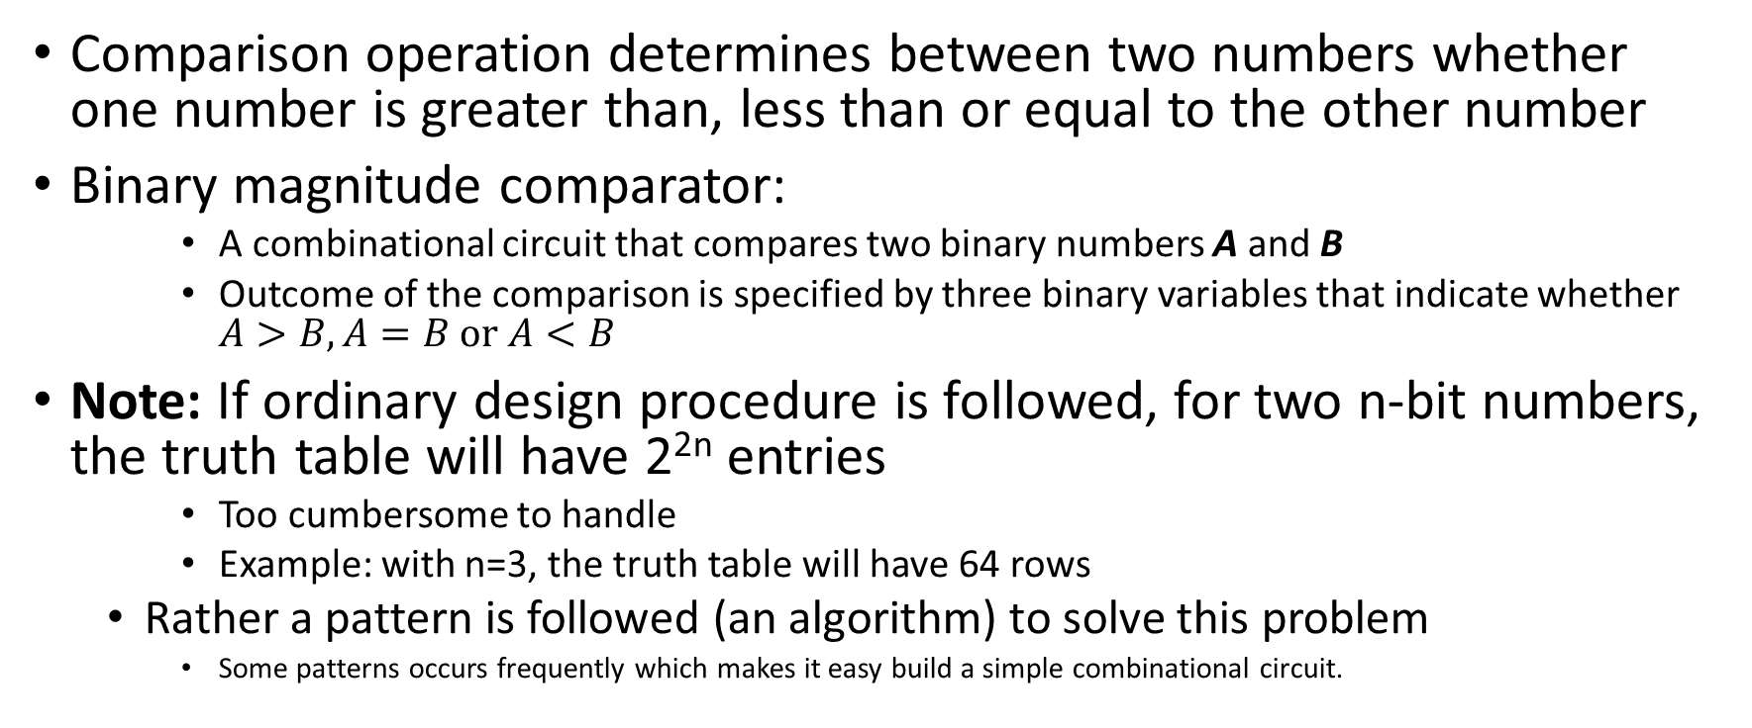
Binary Magnitude Comparator

Slide 11



Binary Magnitude Comparator
Comparator with single bit:
  If A>B
  If A=B
  If A<B
Comparator with Four bits:
  Try the above methods four times and add them up
Expressions:

Slide 12
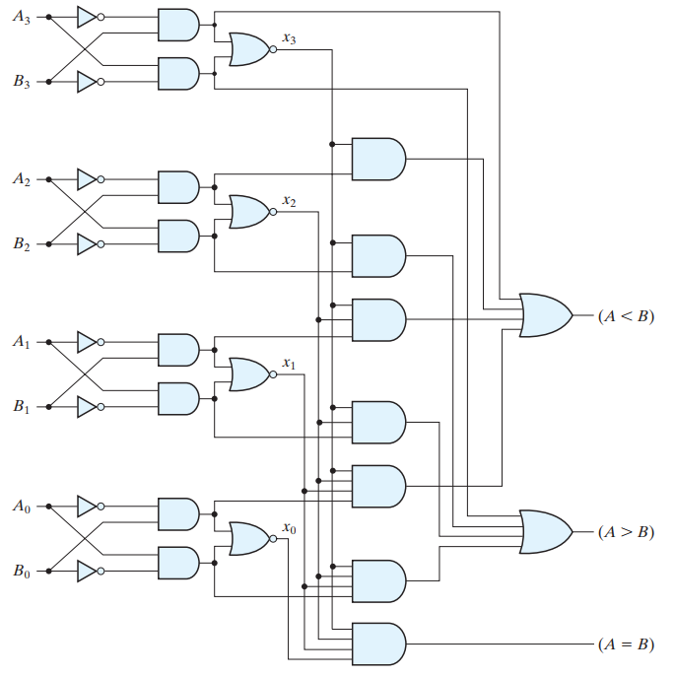
Binary Magnitude Comparator

Slide 13
04
Encoder and Decoder

Slide 14
Encoder and Decoder
Normally, any discrete information can be represented in binary code
  Here, a n-bit binary code can represent 2^{n} different elements
Encoders convert 2^{n} unique lines of input into a code of n bits and Decoders decode the n bits into 2^{n} unique lines.

Slide 15
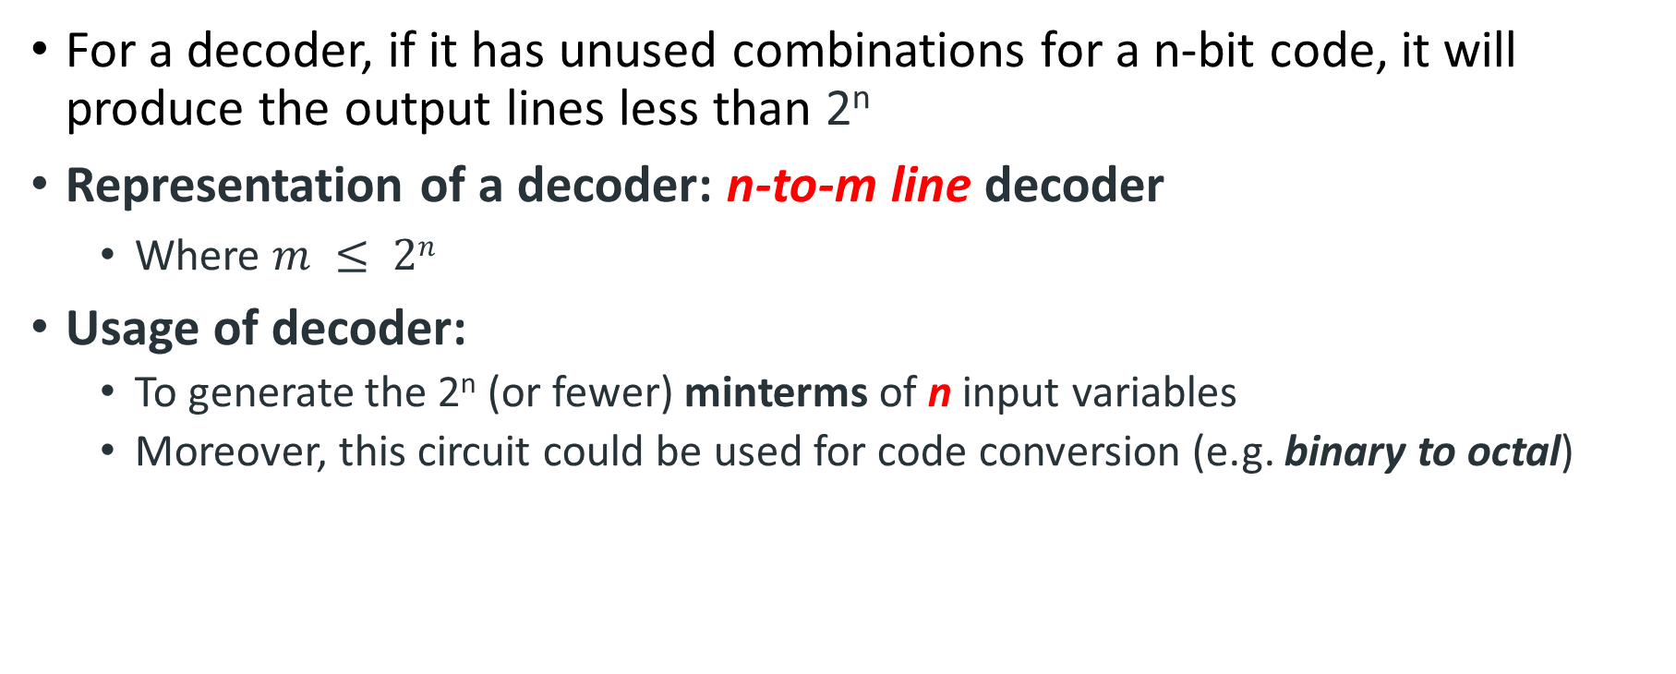
Decoder

Slide 16
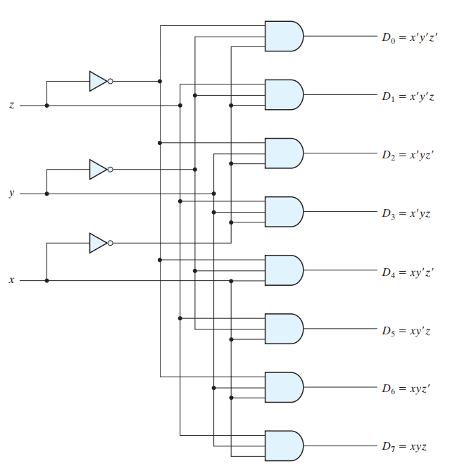
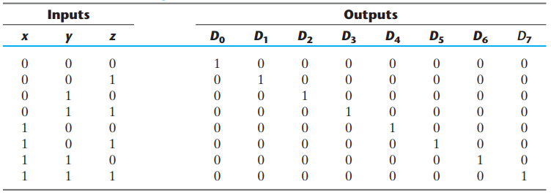
3x8 Decoder: Binary to Octal

Slide 17
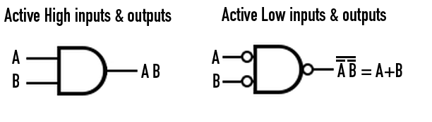
Decoder with NAND Gate and Enable Input
Some decoders are constructed with NAND gates to make it more economical
  In this case, minterms are generated in the complemented form
  Similarly, the operation of the decoder can be controlled with 0s instead of 1s.
Some of them can include one or more enable inputs to control the circuit operations
  Variants: Active-low and active-high enable

Slide 18
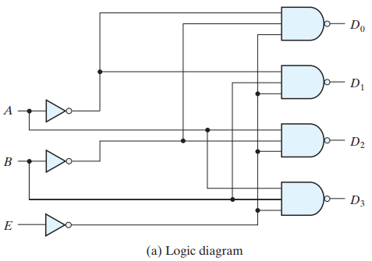
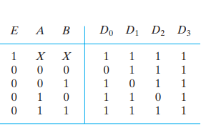
Decoder with NAND Gate and Enable Input
0 is considered “enable” for both inputs and E because of NAND gate
Specialty with “X” in inputs condense the truth table

Slide 19
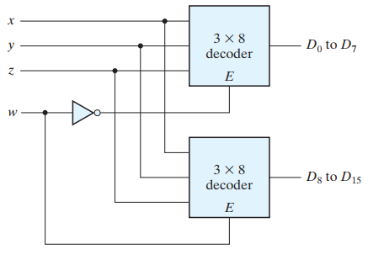
Larger Decoder with Smaller Ones
4x16 decoder with two 3x8 decoders:

Slide 20
Significance of Enable Input
In general, enable inputs are a convenient feature for interconnecting two or more standard components for the purpose of combining them into a similar function with more inputs and outputs.

Slide 21
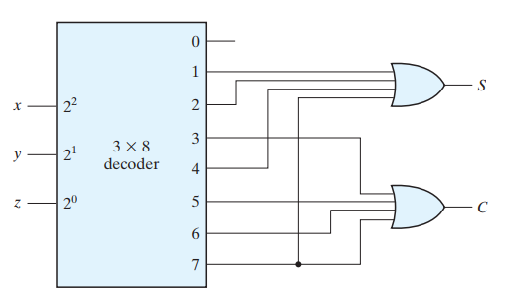

Combinational Circuit with Decoders
We consider the minterms of any function from the truth table of certain Boolean function and add them with an external OR gate for each output variable
Example: Full Adder with 3x8 decoder

Slide 22
Combinational Circuit with Decoders
If the number of minterms (k) is so many (>2^{n}/2) we can consider the F’ with (2^{n}-k) number of minterms
  Then NOR gate will be used instead of OR gate
If the internal gate of the Decoder is NAND gate, the external gate will be also a NAND gate instead of an OR gate
  Two level NAND gate implementation

Slide 23
Encoder
Inverse of Decoder
2^{n} inputs and n outputs
  Only one input will be 1 at a time
Another kind of converter or coder or cryptographer

Slide 24

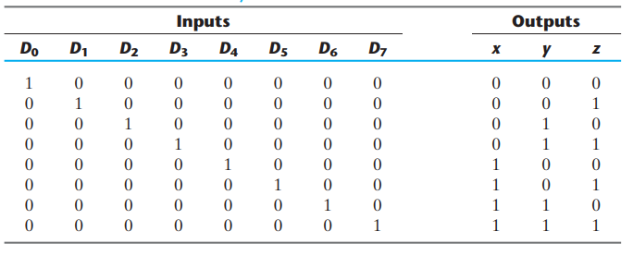
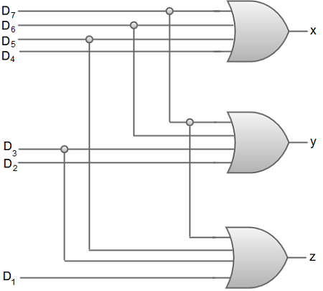
3x8 Encoder: Octal to Binary

Slide 25
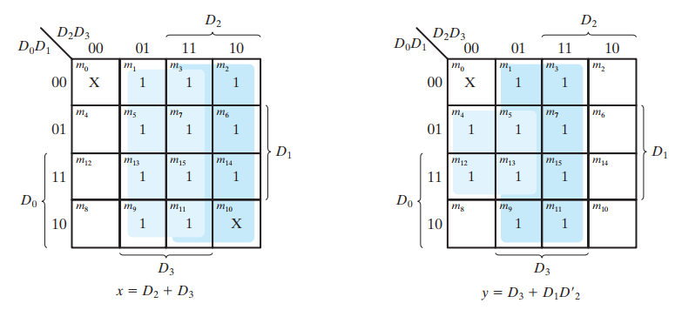
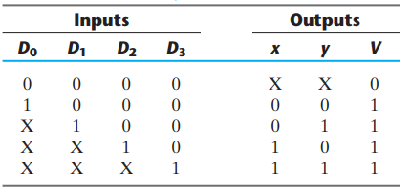

Priority Encoder with additional Output
It includes the priority function for the inputs
Truth table and K-map:

Slide 26
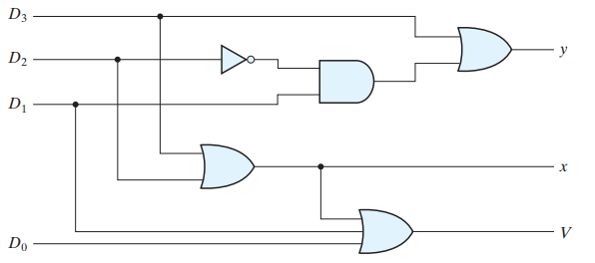
Priority Encoder with additional Output

Slide 27
05
Multiplexer

Slide 28
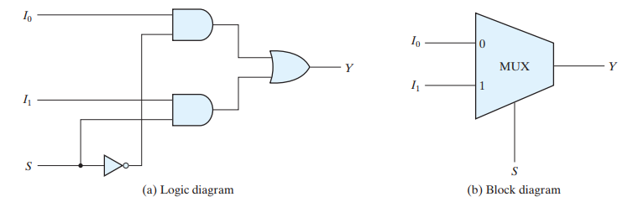
Multiplexer
Also called as data selector
A combinational circuit:
  Selects from one of many input lines and directs it to a single output line
    Selection is controlled by a set of selection lines
  There are 2^{n} input lines and n selection lines
Often labeled as MUX

Slide 29
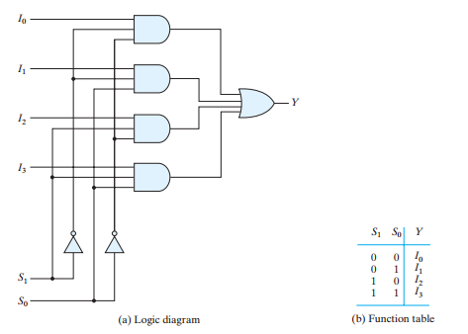
4 to 1 MUX

Slide 30
Multiplexer from Decoder
The AND gates and inverters in the multiplexer resemble a decoder circuit
  Indeed, they decode the selection input lines
  In general, a 2^{n}-to-1-line multiplexer is constructed from an n-to-2^{n} decoder by adding 2^{n} input lines to it, one to each AND gate.
    The outputs of the AND gates are applied to a single OR gate.

Slide 31
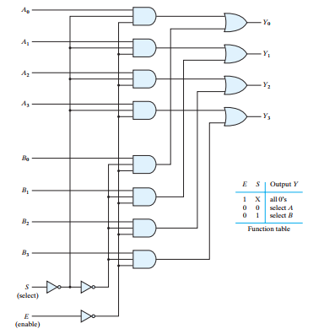
Circuit Implementation with MUX
Multiplexer circuits (more than one) can be combined with common selection inputs to provide multiple-bit selection logic for all of them.

Slide 32
Demultiplexer
Also called as data distributor
Definition: A circuit that receives information from a single line and directs it to one of 2^{n} possible output lines
Selection of a specific output will be controlled by bit combination of n selection lines
A decoder could be used as a demultiplexer
  Here, the enable input in decoder works as the original input in demultiplexer
    Connected with each of the outputs , but only one will be activated specified by the binary combination of the input bits of the decoder
  Decoder with enable input referred as a decoder-demultiplexer

Slide 33
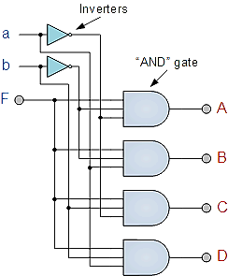
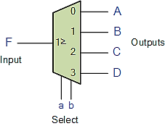
Demultiplexer

Slide 34
Resources
Worksheet 1
Resource 1

Slide 35
Thank You !!
Feel free to ask any questions

